Slide 1
College Enrollment, Graduation, & Employment
Aparna, Brandi and Carter

Slide 2

Motivation and Summary
Goal:
Our project goal is to compare enrollment and completion rates to employment in the US over time.
Key Questions:
Is there a relation between unemployment rate and enrollment or completion rates?
As employment rates decrease, do enrollment rates increase in response?
Can we predict enrollment rates based on current economic trends?
Answers:
We were able to visualize a correlation between enrollment and unemployment rates over time.
Similarly, we’re able to see a relationship between enrollment and completion rates.
We would need more data than what is available to determine cause-and-effect relationship and/or a predictive trend.

Slide 3
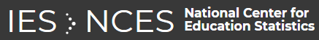
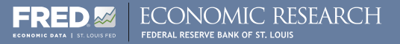
Questions & Data
Based on our questions, what types of data do we need to locate?
Economic data, including unemployment rates
Educational data, including enrollment and completion trends
Data Sources:
National Center for Educational Statistics
Federal Reserve Economic Data

Slide 4
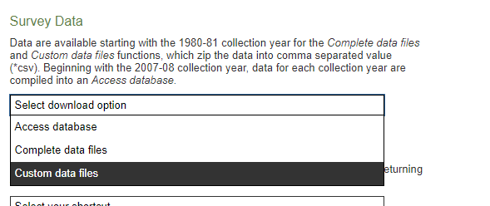
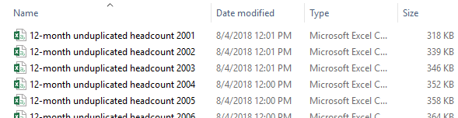
Data Cleanup & Exploration - NCES
NCES Exploration
Many different ways to pinpoint your data needs
User-friendly site, when you know exactly what you need
NCES Data Files Obtained
Separate enrollment files per year (2001-2017)
Separate completion (a.k.a., degrees awarded) files per year
(2001-2017 for enrollment, 2005-2017 for completions)
Merged using “copy*combine.csv” command line
Cleanup
Removed extraneous columns
Removed rows with missing data
Problems
Many holes in the completion data

Slide 5
Data Analysis
* Discuss the steps you took to analyze the data and answer each question you asked in your proposal * Present and discuss interesting figures developed during analysis, ideally with the help of Jupyter Notebook
CHARTS GO HERE ☺

Slide 6
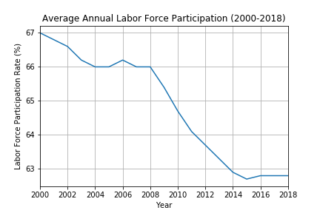
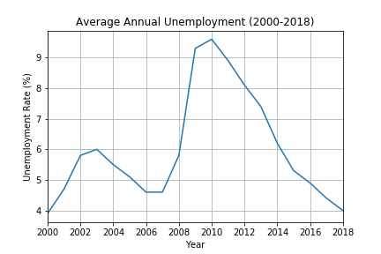
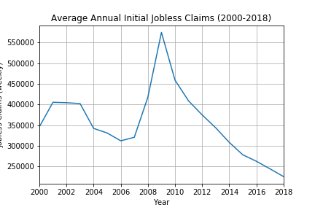

Slide 7
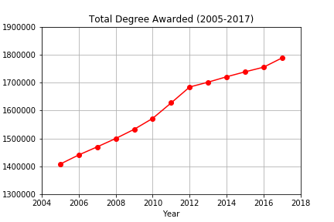
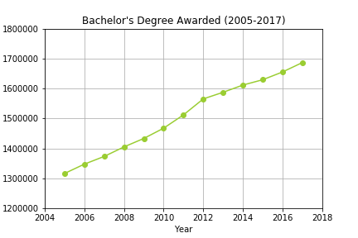
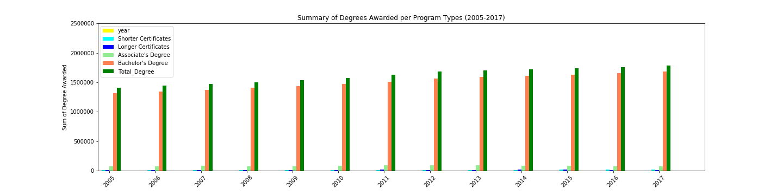

Slide 8
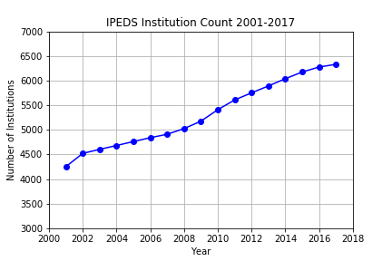
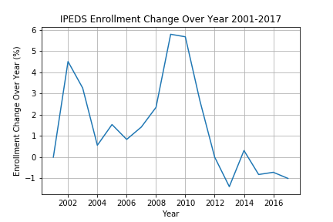

Slide 9
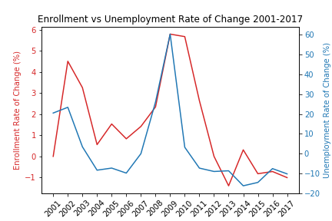
Discussion
* Discuss your findings. Did you find what you expected to find? If not, why not? What inferences or general conclusions can you draw from your analysis?

Slide 10
Post Mortem
* Discuss any difficulties that arose, and how you dealt with them * Discuss any additional questions that came up, but which you didn't have time to answer: What would you research next, if you had two more weeks?

Slide 11
Questions
* Open-floor Q&A with the audience

